Slide 1
CPSC 8810 Data Visualisation Final
Project Presentation
DIVERSITY AT CLEMSON UNIVERSITY
by Radhika Dhaipule

Slide 2
What data to visualize?
Which parts of the world are graduate students at Clemson from?
How many students belong to each part of the world?
Field of study of the students.

Slide 3
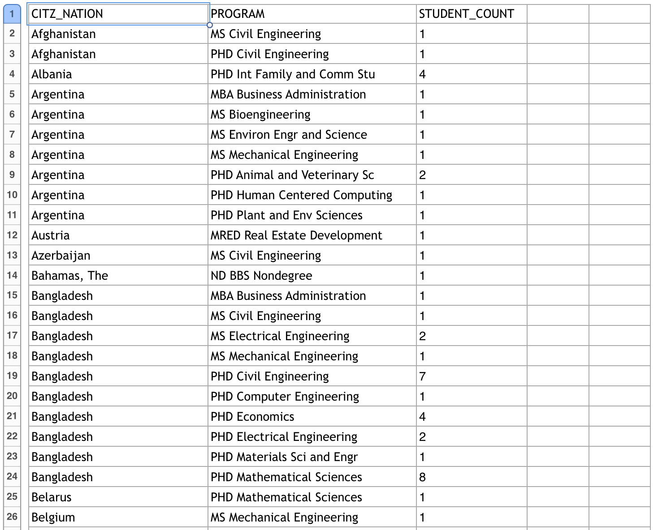
Data Used

Slide 4
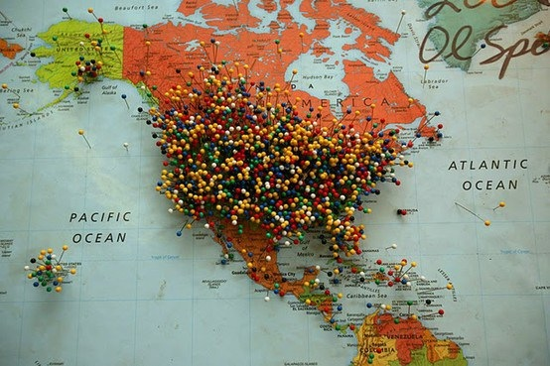
Inspiration for the idea
The map at All In Cafe, Clemson

Slide 5
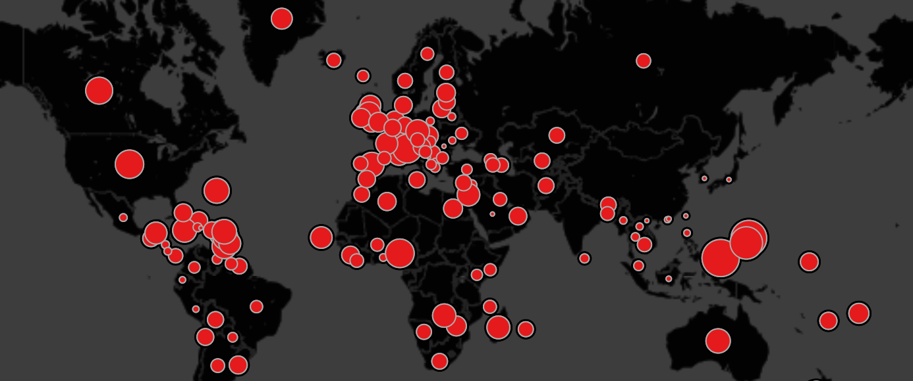
Visualisation techniques used
Maps and points (size dependent on the density)

Slide 6
Interaction techniques used
Click on data points on the map to display data about the dominant field of study pursued in that particular region
Allow user to select a particular country or a particular field of study and display data accordingly

Slide 7
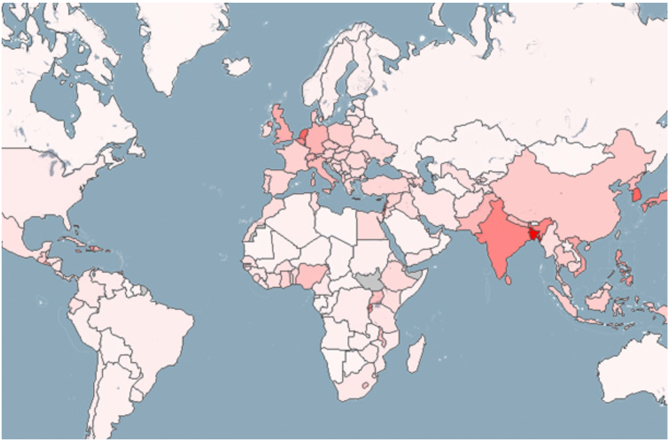
Alternative technique - Choropleth Map

Slide 8
Tools and Resources used
Tool - Processing
Library for maps - Unfolding Library
Library for control panel - controlIP5

Slide 9
Questions?

Slide 10
Thank you!

